Slide 1
Health Hub
CSP-584 Project Phase 2
Team No. 9
Jiabin Wang A20407756
Vidhi Mittal A20449865
Haoli Yang A20455080

Slide 2
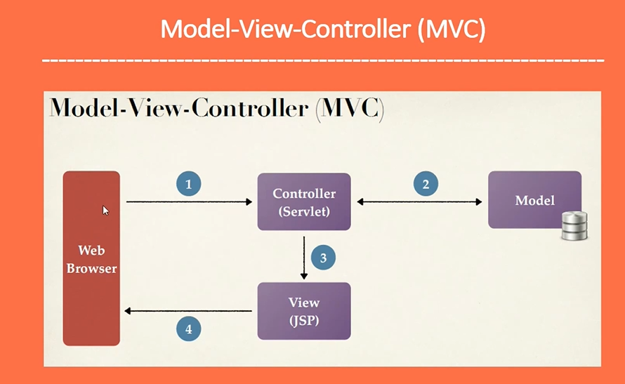
Architecture

Slide 3
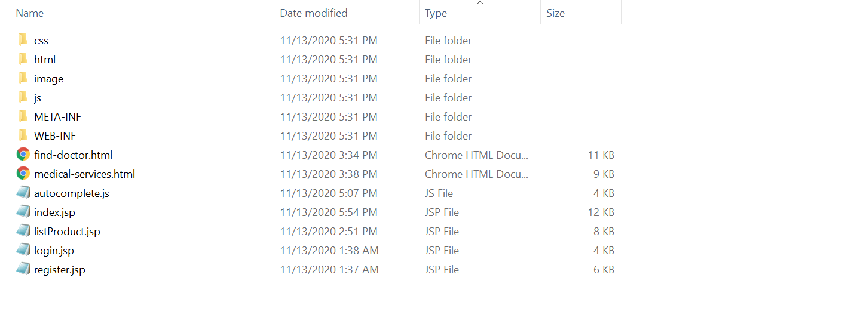
Architecture
Font End Design

Slide 4
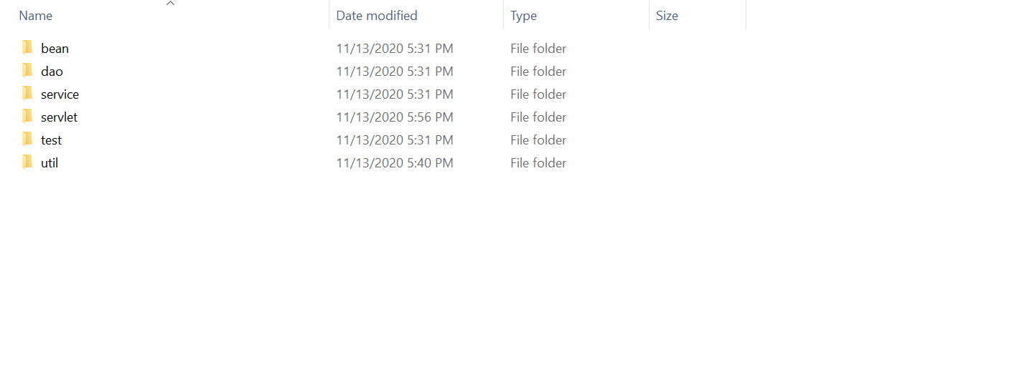
Architecture
Back End Design

Slide 5
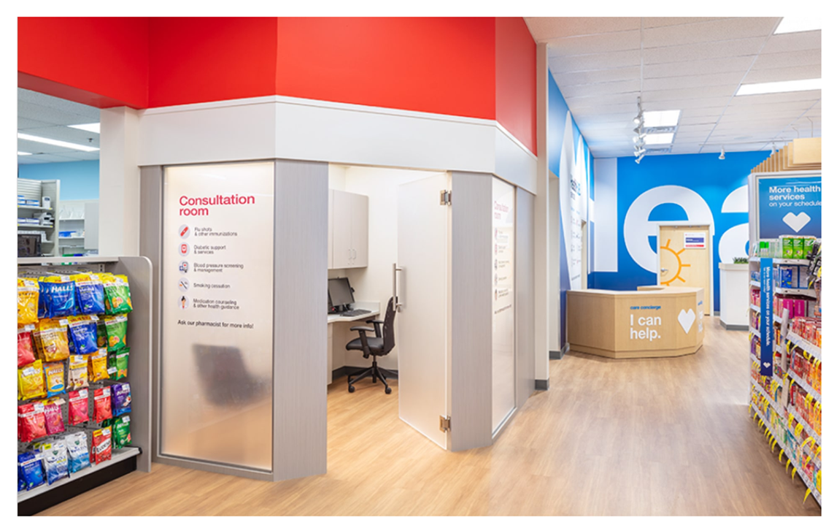
Features In Progress
1
Login/Logout/Register
2
Autocomplete Search/ Product Listing
3
Search nearby doctor/medical services/hospital on the Google Map
4
Product/User CRUD

Slide 6
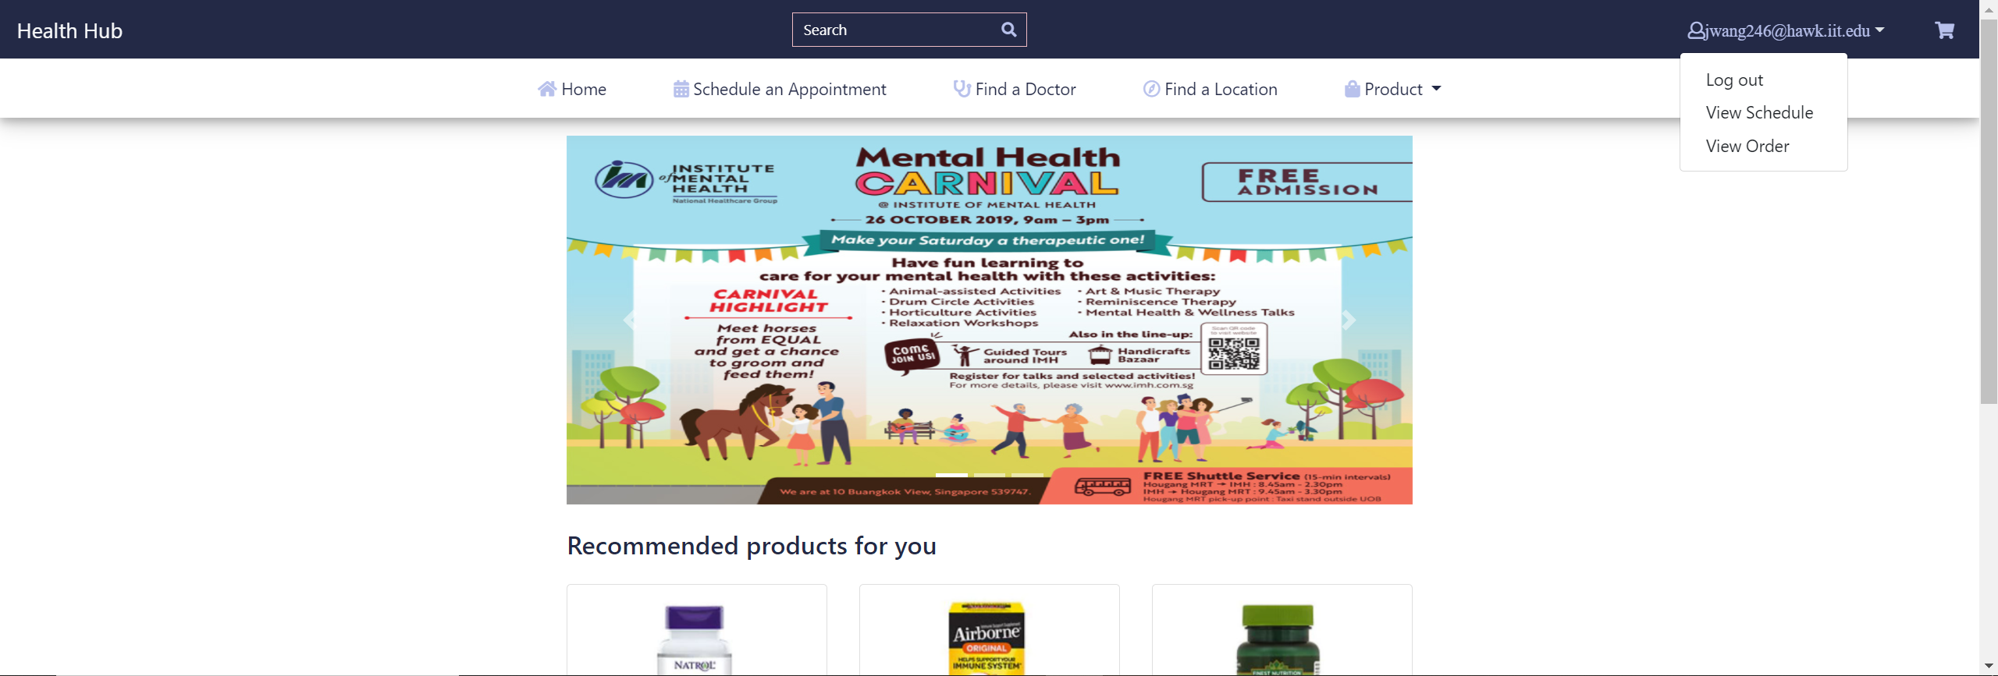
Page Demo

Slide 7
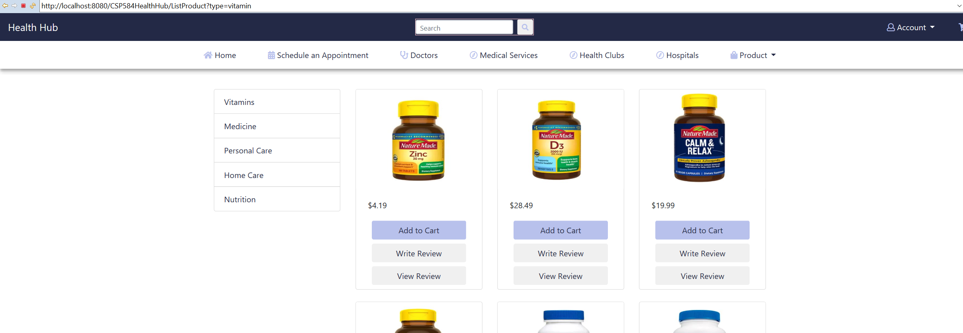
Page Demo

Slide 8
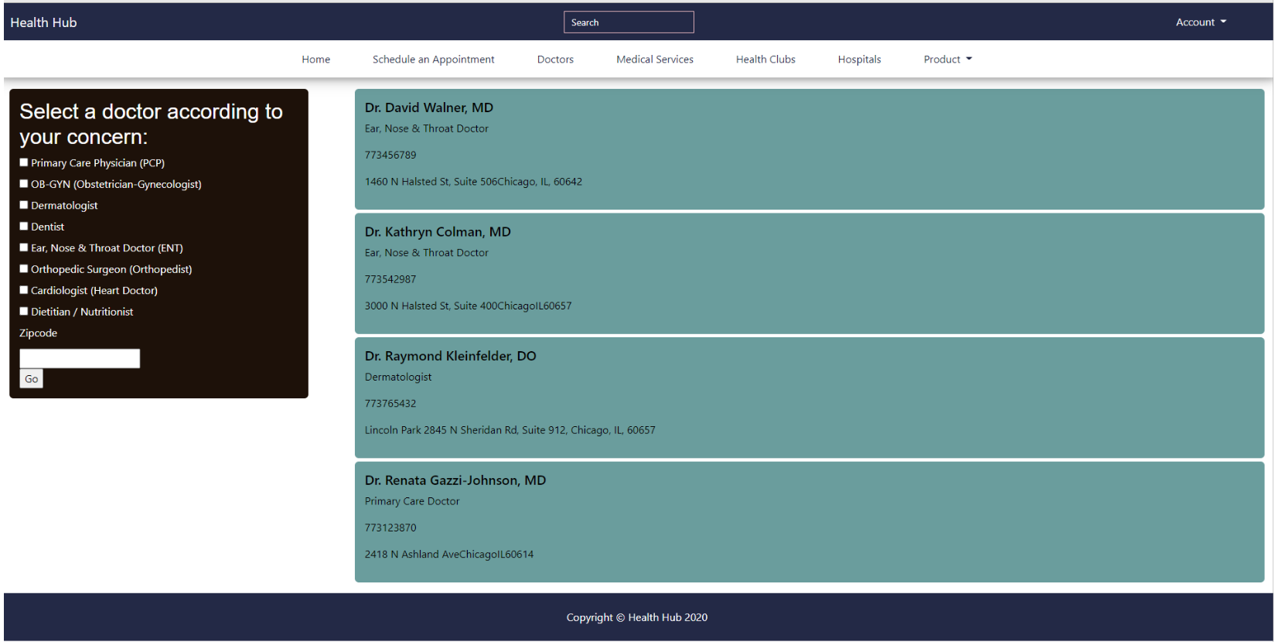
Page Demo

Slide 9
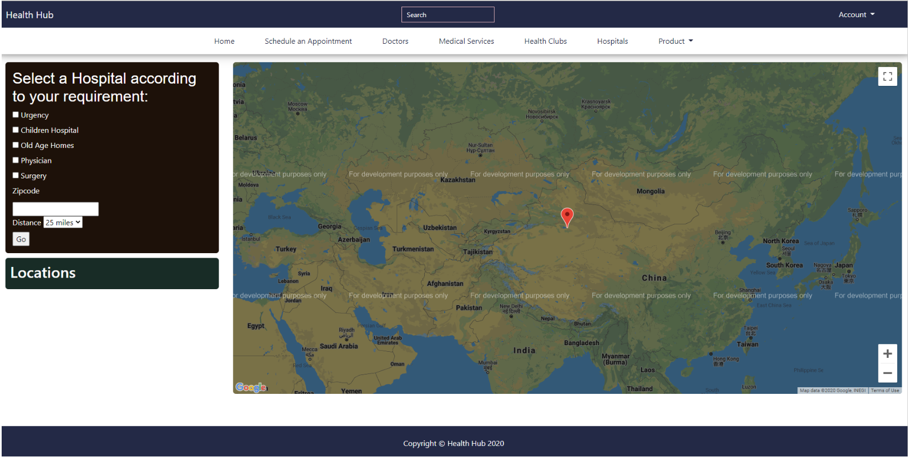
Page Demo

Slide 10
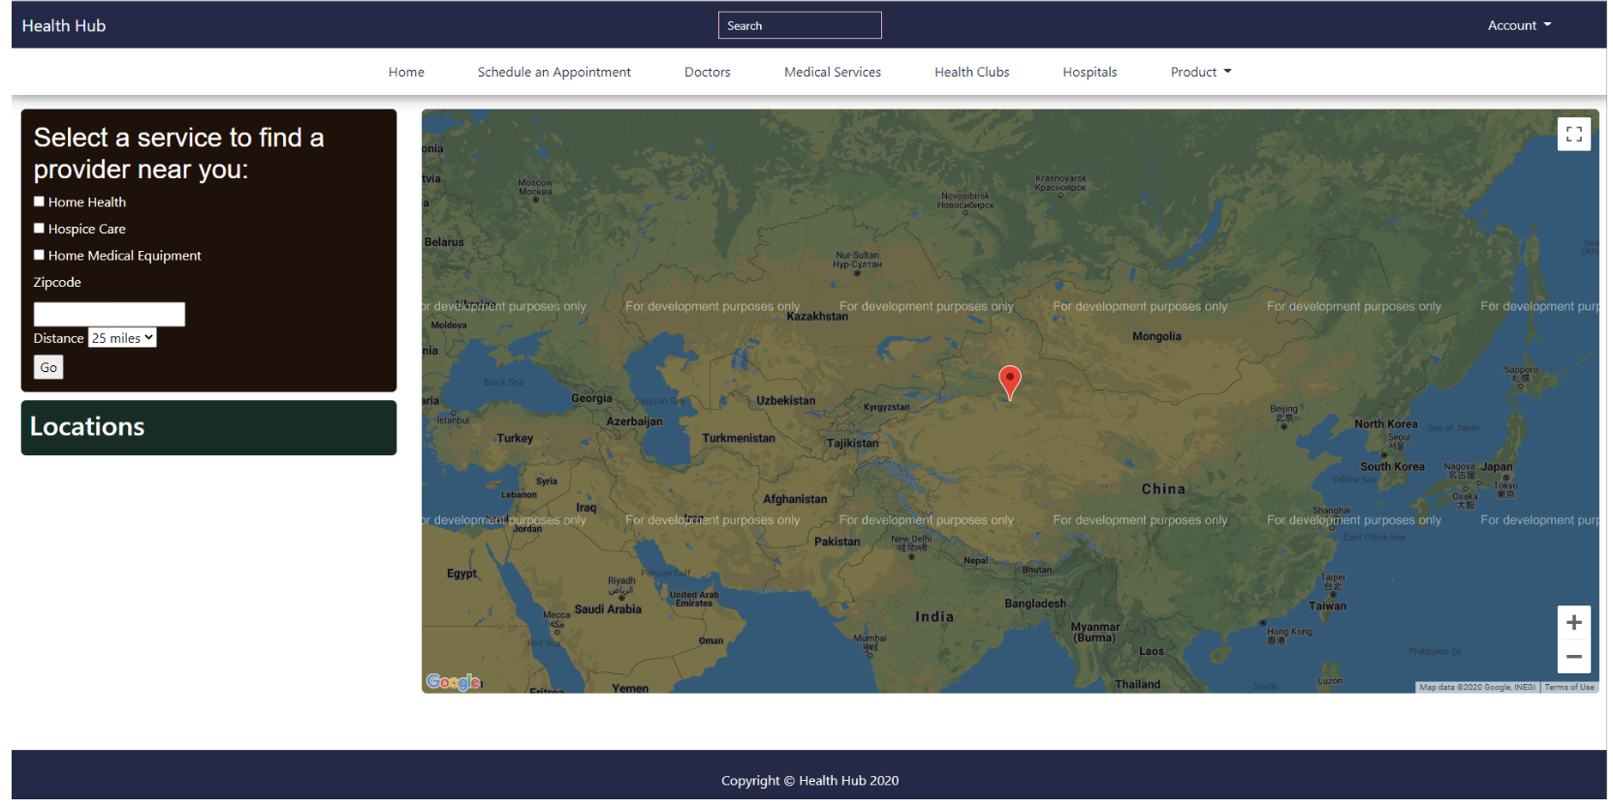
Page Demo

Slide 11
Feature Need To Be Implemented
1
Data analytics
2
Real-time events/news
3
Product recommendations
4
Reviews & Trending products

Slide 12
Thanks
Notes:
在“幻灯片放映”模式下，选择箭头访问相应链接。

